Slide 1
Algo Trading
Black Scholes model

Slide 2
Algo Trading
Background
Trading Strategies
Improvement of Long Straddle
Conclusion
Notes:
This research is to find profitable strategies on the derivatives market in Hong Kong. For that purpose, we studied Black-Scholes Model and constructed three trading strategies: 1) Lock Profit, 2) Call and Put Parity, 3) Long Straddle and Gamma Scalping. These strategies represented three different risk management philosophies as we can observe how Black-Scholes formula impact derivatives market and individual investment decision.

Slide 3
Algo Trading
Background
Black-Scholes Model
Market View
Trading Strategies
Improvement of Long Straddle
Conclusion

Slide 4
Black-Scholes Model
The Black–Scholes model is a mathematical model of a financial market containing certain derivative investment instruments. From the model, one can deduce the Black–Scholes formula, which gives a theoretical estimate of the price of European-style options.

Slide 5
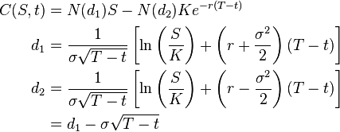
N() is the cumulative distribution function of the standard normal distribution.
T-t is the time to maturity
S is the spot price of the underlying assert
K is the strike price
R is the risk free rate
σis the volatility of returns of the underlying assert

Slide 6
Follows a lognormal distribution; that is, returns on the underlying are normally distributed.
The risk-free rate and volatility of the underlying are known and constant
The options are European and can only be exercised at expiration
Efficient markets (i.e., market movements cannot be predicted)
No commissions
Notes:
assumption

Slide 7
In Practice
Volatility surface
Price option
Risk measures(Greeks)
Notes:
Results using the Black–Scholes model differ from real world prices because of simplifying assumptions of the model. One significant limitation is that in reality security prices do not follow a strict stationary log-normal process, nor is the risk-free interest actually known (and is not constant over time).

Slide 8
Data Source
Tick data, including HSI, HSI Option and HSI Future, is from November 2013 to December 2013
Schema of Date/Time, Product, Accumulated Traded, (Bid price, Bid Qty) x 5, (Ask price, Ask Qty) x 5.
At preprocessed period, I will use a model to deduce current market order price for back testing.

Slide 9
Data Source
tick | Product | last traded | Accum. trade | Bid information(price, qty) |  |  |  |  |  |  |  |  |  | Ask information(price, qty)
091818 | HSI23000W3 | 200 | 3 | 191 | 18 | 182 | 5 | 148 | 1 | 130 | 1 | 0 | 0 | 204 | 5 | 206 | 1 | 210 | 13 | 212 | 5 | 0 | 0
091818 | HSI22800W3 | 144 | 1 | 139 | 13 | 138 | 5 | 131 | 1 | 127 | 5 | 86 | 1 | 148 | 5 | 154 | 13 | 157 | 5 | 160 | 15 | 0 | 0
Notes:
Tick data, including HSI, HSI Option and HSI Future, is from November 2013 to December 2013 with schema of Date/Time, Product, Accumulated Traded, (Bid price, Bid Qty) x 5, (Ask price, Ask Qty) x 5. At preprocessed period, I will use a model to deduce current market order price for back testing.

Slide 10
Data Source
tick | Product | last traded | Accu trade | Bid information(5*(price, qty)) |  |  |  |  |  |  |  |  |  | Ask information(5*(price, qty))
091818 | HSI23000W3 | 200.0 | 3 | 191 | 18 | 182 | 5 | 148 | 1 | 130 | 1 | 0 | 0 | 204 | 5 | 206 | 1 | 210 | 13 | 212 | 5 | 0 | 0
091818 | HSI22800W3 | 144 | 1 | 139 | 13 | 138 | 5 | 131 | 1 | 127 | 5 | 86 | 1 | 148 | 5 | 154 | 13 | 157 | 5 | 160 | 15 | 0 | 0
Notes:
Back to the data, when I construct my trading strategy, I need fetch out 9 main values of option tick, including tick, strike price, maturity day, option type, last trade price, last trade time, accumulated number, ask price, bid price, and 7 main values of future option accordingly. To simplified model, I used the first ask price and the first bid price as ask price and bid price. As to HSI, I just fetch out tick and price, and then insert it into database.

Slide 11
Tradable and Available Market Price
tick | Product | last traded | Accu trade | Bid information(5*(price, qty)) |  |  |  |  |  |  |  |  |  | Ask information(5*(price, qty))
091818 | HSI23000W3 | 200.0 | 3 | 191 | 18 | 182 | 5 | 148 | 1 | 130 | 1 | 0 | 0 | 204 | 5 | 206 | 1 | 210 | 13 | 212 | 5 | 0 | 0
091818 | HSI22800W3 | 144 | 1 | 139 | 13 | 138 | 5 | 131 | 1 | 127 | 5 | 86 | 1 | 148 | 5 | 154 | 13 | 157 | 5 | 160 | 15 | 0 | 0
GET MARKET PRICE MODEL
If ask price or bid price is invalid: return invalid
If current - last trade time < 5 ticks: return last trade price
If the spread of ask/bid price < its middle price * 0.02: return middle price
Else: return invalid
Notes:
Since sometimes the spread of bid and ask price will be quite large and we cannot long/short at that time, we need a price model to calculate current market price.

Slide 12
Trading Session
Last month Before Maturity in Products
No trading in last 5 days
Notes:
Generally speaking, the trading days of the HANG SENG Index Option is just without holidays, but the data show, before maturity day of the option, price of option will become unpredictable and unstable in some degree because some assumptions of Black and Scholes Model are no longer correct. Obviously, we decided to not trade on these trading days for simplified trading strategies.

Slide 13
Position and Cost
For strategy 1), we will try to long/short position every tick.
For strategy 2), every 180 seconds
For strategy 3), every 300 seconds
Assume that as long as strategy places an order, it will be executed.
No transaction costs.
Overnight trading can also be allowed for pursuing more profits.
Notes:
For strategy 1), we will try to long/short position every tick while we will employs strategy 2) and 3) every 180 seconds and 300 seconds respectively. On the other hand, we assume that as long as strategy places an order, it will be executed. Besides, we only take the first bid/ask price into account for calculating profits and premium costs would not be added in our back testing. Furthermore, overnight trading can also be allowed for pursuing more profits.

Slide 14
Algo Trading
Background
Trading Strategies
Improvement of Long Straddle
Conclusion

Slide 15
Trading Strategy
1. Lock Profit
2. Call and Put Parity
3. Long Straddle and Gamma Scalping
Notes:
When I was seeking or designing a proper strategy for achieving a profitable return by going long or short in markets, I figure out it always exists uncertainty. And without a statistically reliable measurement of the risk-adjusted reward, it is impossible to assess whether future performance is in line with historical performance. Since I am a Conservative investors, I don’t want make things complex and out of my control. I start to learn some risk-free arbitrage strategies or delta neutral strategies in Hong Kong option market. So, here, I will represent three trading strategies from simple to complex, from risk-free to risky.

Slide 16
Trading Strategy
1. Lock Profit
2. Call and Put Parity
3. Long Straddle and Gamma Scalping
Notes:
1. Lock Profit
2. Call and Put Parity
3. Long Straddle and Gamma Scalping

Slide 17
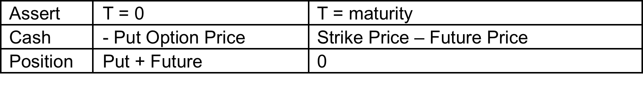
Lock Profit
It is clearly that if what you gain in maturity day (Strike Price – Future Price) is bigger than what you paid in T=0 (Put Option Price), strategy have profits.

Slide 18
Mathematical Expression
Entry Signal:
Put option Price < Strike Price – Future Price
Call option Price < Future Price – Strike Price
Notes:
This strategy only needs to calculate “Entry Signal”. Once order placed, the profit will be locked and the portfolio will be hold to the maturity day, which means we do not need to consider when to exit position.

Slide 19
Condition and Limitation
Risk-free Strategy
Entry signal occurs at rare chance
Simple Strategy
Depends on the hardware capacity.
Notes:
Since this strategy is risk-free, the entry signal occurs at rare chance, which means it is impossible to place this kind of orders frequently. Since everybody will employ that kind of strategy, success maybe depends on the hardware capacity.

Slide 20
Back Testing Result
Total Trades = 11
Total Points Earned = 19.0
Total Trading Day = 1
Average Points Earned per Day = 19.0
Average Points Earned per Trade = 1.727
Notes:
As the back testing shows, all trades occurred in one day and average points earned per trade is below 2 points. It is not an ideal strategy as what we expected. Considering the commission of each trade, this strategy will lose money.

Slide 21
Trading Strategy
1. Lock Profit
2. Call and Put Parity
3. Long Straddle and Gamma Scalping
Notes:
1. Lock Profit
2. Call and Put Parity
3. Long Straddle and Gamma Scalping

Slide 22
Call and Put Parity
C₀^{T}+Ke^{−rT}=P₀^{T}+S(0)
In financial mathematics, put–call parity defines a relationship between the price of a European call option and European put option, both with the identical strike price and expiry, namely that a portfolio of long a call option and short a put option is equivalent to (and hence has the same value as) a single forward contract at this strike price and expiry.
Notes:
This is because if the price at expiry is above the strike price, the call will be exercised, while if it is below, the put will be exercised, and thus in either case one unit of the asset will be purchased for the strike price, exactly as in a forward contract.

Slide 23
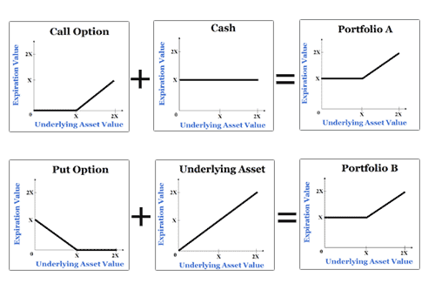
Consider two portfolios at T = 0:
One Call option + Ke^{−rT} risk-free zero-coupon bond.
One Put option + unit of the asset
It is trivial to see the payoff of two portfolios at T = Maturity day:
MAX(S(T) – K, 0) + K = MAX(S (T), 0)
MAX(K – S(T), 0) + S(T) = MAX(S (T), 0)

Slide 24
C₀^{T}+Ke^{−rT}=P₀^{T}+Fe^{−rT}
r is almost zero in HK
T is smaller than 2 month in our strategy
So e^{−rT} will be very close to 1

Slide 25
The “no arbitrage” Interval
C - P+ K - Com < F < C - P+ K + Com
Com : Commission
K : Strike Price

Slide 26
Mathematical Expression
Entry Signal:
Future price > Call option price - Put option price + strike price + Commission
Future price < Call option price - Put option price + strike price - Commission
Notes:
This strategy only needs to calculate “Entry Signal”. Once order placed, the profit will be locked and the portfolio will be hold to the maturity day, which means we do not need to consider when to exit position.

Slide 27
Mathematical Expression
Exit Signal:
Portfolio back to the normal situation according with call-put parity.
Future price < Call option price - Put option price + strike price + Commission
Future price > Call option price - Put option price + strike price - Commission
Stop Loss Point (5%)
Notes:
This strategy only needs to calculate “Entry Signal”. Once order placed, the profit will be locked and the portfolio will be hold to the maturity day, which means we do not need to consider when to exit position.

Slide 28
Condition and Limitation
Almost Risk-free Strategy
Entry signal occurs at rare chance
Depends on the hardware capacity.
Notes:
Since this strategy is risk-free, the entry signal occurs at rare chance, which means it is impossible to place this kind of orders frequently. Since everybody will employ that kind of strategy, success maybe depends on the hardware capacity.

Slide 29
Back Testing Result
Commission | Both Side | Total Trades | Total Pts. | Avg. Pts Per Tx. | Hold Maturity Tx
3 | No | 10 | 81.5 | 8.15 | 3
3 | Yes | 9 | 104.5 | 11.611 | 4
6 | No | 1 | 30.5 | 30.5 | 0
Notes:
The table also describes that the total trade and total point earned are quite small, since this strategy is also a risk-free arbitrage strategy. And if the commissions are take into account, we just earned little money. As we all known, one cannot make large amount of money by a risk-free strategy. The results make sense.

Slide 30
Trading Strategy
1. Lock Profit
2. Call and Put Parity
3. Long Straddle and Gamma Scalping
Notes:
1. Lock Profit
2. Call and Put Parity
3. Long Straddle and Gamma Scalping

Slide 31
Greeks
Delta
Gamma
Theta
Notes:
In mathematical finance, the Greeks are the quantities representing the sensitivity of the price of derivatives such as options to a change in underlying parameters on which the value of an instrument or portfolio of financial instruments is dependent. These sensitivities, also known as hedge ratios, are commonly referred to as the Greeks since many of them are labeled by Greek letters.

Slide 32

Delta
Delta is the first partial derivative of an option with respect to the price of the underlying. Usually the first thing we want to control.
Measures the rate of change of option value with respect to changes in the underlying asset's price
The absolute value of delta is the probability that the option will end up in-the-money.

Slide 33

Delta

Slide 34
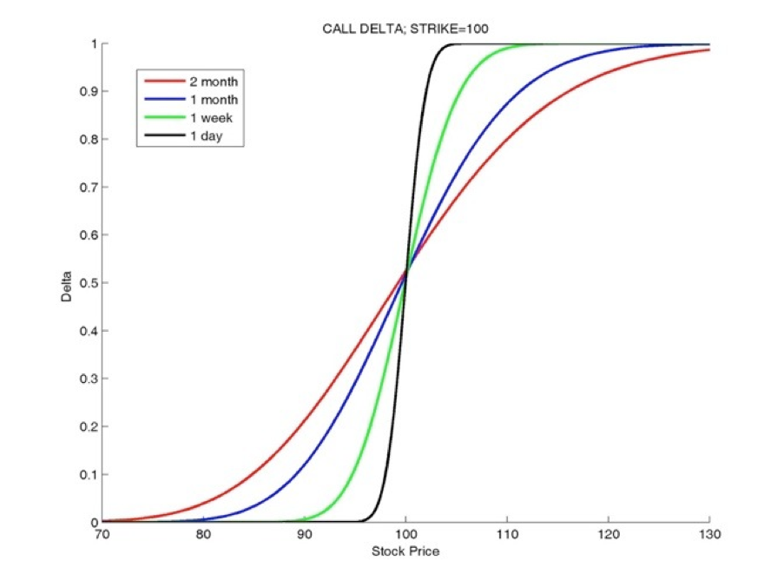
Delta
Notes:
For Long option,
Call delta: 0 (out-of-money) <Δ< 1 (deep in-the-money)
Put delta: -1 (deep in-the-money) <Δ< 0 (out-of-money)
shows that delta becomes less sensitive to changes in asset prices as the maturity increase. You can also find that delta of at-the-money option is always around 0.5.

Slide 35
Delta Natural
Delta Hedging
Delta == 0 ; keeping the delta of a portfolio as close to zero as possible
An options strategy that aims to reduce (hedge) the risk associated with price movements in the underlying asset by offsetting long and short positions.
Notes:
You don’t care the price up or down, you will make money in either direction.

Slide 36

Gamma
Gamma is the second partial derivative of an option with respect to the price of the underlying
Measures the rate of change in the delta with respect to changes in the underlying price.
All long options have positive gamma and all short options have negative Gamma.

Slide 37
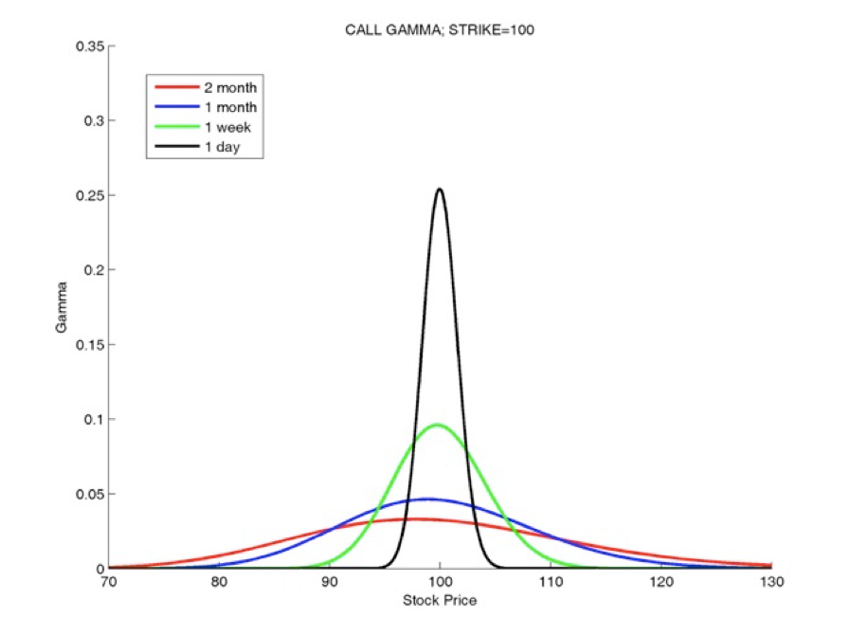
Gamma
Notes:
Figure shows that gamma is greatest approximately at-the-money and diminishes the further out you go either in-the-money or out-of-the-money.
Gamma is important because Gamma shows how volatile an option is relative to movements in the underlying asset. So, by watching your gamma will let you know how large your delta (position risk) changes.

Slide 38
Long Gamma
Long Option
Expected Market move
When market move, it reinforce the long position
When gamma is high, the relation is more convex than linear
Notes:
When you long gamma, your position will become "longer" as the price of the underlying asset increases and "shorter" as the underlying price decreases. That is, when you are long an option (long gamma) you want the market to move. As the underlying price increases, you become longer, which reinforces your newly long position. In other words, when gamma is high, the relation is more convex than linear, and the P&L is more likely to be large in the presence of large moves, which is what “long gamma” traders expected.

Slide 39

Theta
Theta measures the rate (sensitivity) of change of the option price with respect to the passage of time.
“time decay”
Theta is almost always negative for long calls and puts and positive for short (or written) calls and puts
This means that, if time passes with the price of underlying asset and its volatility remaining the same, the value of the option will decrease.
Notes:
measures the rate of change of option value with respect to changes in the underlying asset's price

Slide 40
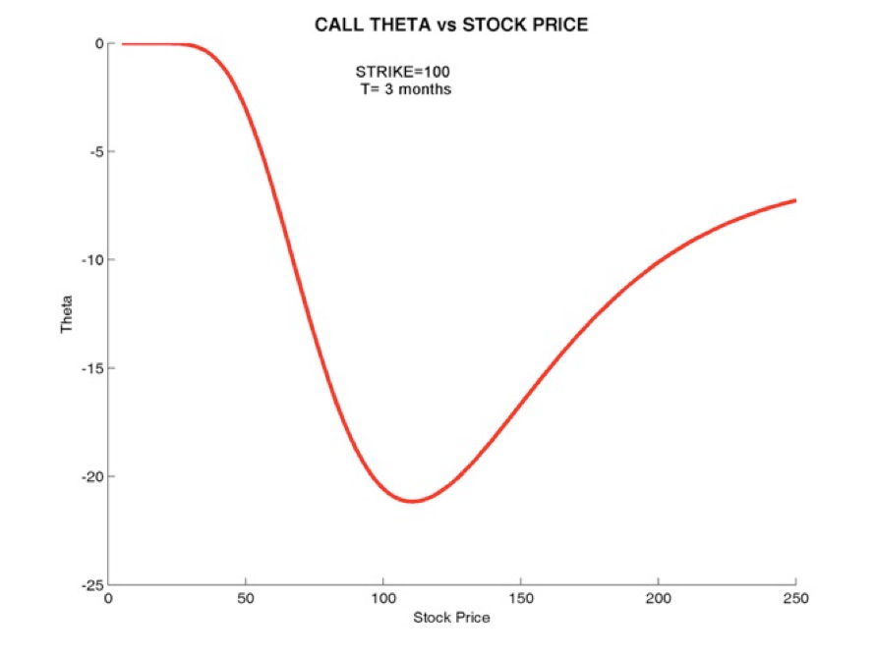
Theta
Notes:
Since time decay is not linear, an option will lose greater percent of its daily value near maturity. The chart below describes that relationship.

Slide 41
Trading Strategy
1. Lock Profit
2. Call and Put Parity
3. Long Straddle and Gamma Scalping
Long Straddle
Gamma Scalping
Notes:
Now here I will combine the Delta Natural and Long Gamma into Strategy 3, we call Long Straddle and Gamma Scalping

Slide 42
Long Straddle
Combination of Long call option and Long put option.
Same strike price and maturity day
Delta Natural Strategy

Slide 43
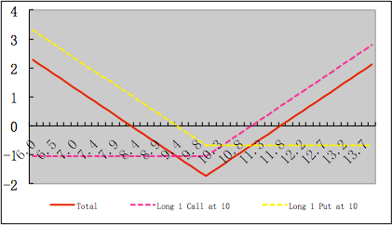
Long Straddle
Notes:
This is the payoff of Long Straddle. As I mention before, Delta Natural no need consider the direction of price move. The combination generally profits if the stock price moves sharply and the in either direction, with delta neutral, during the life of the options. The long straddle is a limited risk, theoretically unlimited profit potential strategy.

Slide 44
Risks of Long Straddle
High implied volatility of the market before longing a straddle
Theta of the straddle.
Notes:
If the market has a very high volatility level due to some recent event, it may not be the best time for a straddle. In other words, this strategy's success would be fueled by an increase in implied volatility.
If that happens and the stock price may remain very stable, the time decay (theta) will take its toll on the position. Because this strategy consists of being long a call and a put, both of them at-the-money at least at the beginning, every day that passes without a move in the stock's price will cause the total premium of this position to suffer a significant erosion of value. Noted that theta is biggest negative value in at-the-money option. What's more, the rate of time decay can be expected to accelerate toward the last days of the strategy.

Slide 45
Risks of Long Straddle
High implied volatility of the market before longing a straddle
Find or Predict Futures’ Volatility
Theta of the straddle.
Gamma scalping
Notes:
SO we have two method to cover these risk

Slide 46
Implied Volatility
In financial mathematics, the implied volatility of an option contract is that value of the volatility of the underlying instrument which, when input in an option pricing model (such as Black–Scholes) will return a theoretical value equal to the current market price of the option.(From WIKI)
Notes:
Which means you can use BS model to calculate iv directly, when you know all the other parameters.

Slide 47
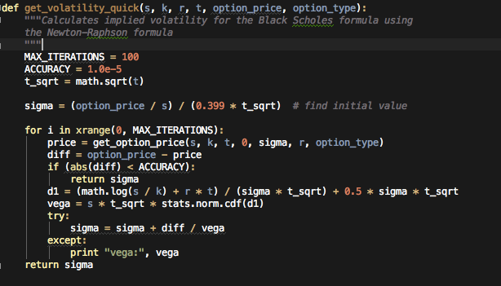
Implied Volatility

Slide 48
Predict Volatility Model
Simple
Assumed that if implied volatility smaller than historical volatility, the implied volatility will increase.

Slide 49
Trading Strategy
1. Lock Profit
2. Call and Put Parity
3. Long Straddle and Gamma Scalping
Long Straddle
Gamma Scalping
Notes:
One tool that can be employed by aggressive traders is known as gamma scalping.

Slide 50
Gamma scalping
Gamma measures the rate of change in the delta with respect to changes in the underlying price.
Gamma Scalping allows traders to take advantage of market movement, whether up or down.
Gamma Scalping will lose money while the market remains flat.
Notes:
Gamma scalping allows traders to take advantage of market movement, whether up or down, at the time that it happens. If the market goes up and then comes back down, then the profit loss as the value of the trader’s position goes back down. They re-center their positions, in effect, so they can profit from future movements. Gamma scalping allows the trader to realize some of the profit from market movements before the market can move in the opposite direction.
Further more, Gamma measures the rate of change in the delta with respect to changes in the underlying price. All long options have positive gamma and all short options have negative gamma. Gamma is greatest approximately at-the-money and diminishes the further out you go either in-the-money or out-of-the-money. Consequently, for make Gamma bigger, which means that the delta can change rapidly with movement in the underlying, this is what we expect. So trader need to long at the money option.

Slide 51
Gamma scalping
Using ATM Option
Biggest value of Gamma
Always Long Option
Make Delta < 10%
Notes:
More specifically, when the deltas are no longer balanced, we will do Gamma scalping. If the price of the underlying asset went down, then the new delta sum is negative. The investor long the at the money call options to rebalance the delta. If the price of the underlying asset went up, then the investor long put options. Bringing the delta back into balance allows the investor to go back to a neutral position, from which he can profit regardless of the direction of subsequent market movements.

Slide 52
^{Long Straddle & Gamma Scalping}
Notes:
Here I will show you a real example.

Slide 53
^{Long Straddle & Gamma Scalping}

Slide 54
^{Long Straddle & Gamma Scalping}
AT 1107
HSI:23000
Long Call: 263
Long Put: 365
COST = 263 + 365 = 628

Slide 55
^{Long Straddle & Gamma Scalping}

Slide 56
^{Long Straddle & Gamma Scalping}
AT 1112
HSI:23000
Short Call: 301
Short Put: 280
COST = 301 + 280 = 581
P/L: 581 – 628 = -47

Slide 57
^{Long Straddle & Gamma Scalping}

Slide 58
^{Long Straddle & Gamma Scalping}
AT 1108
HSI:22800
Long Call: 255
COST = 628 + 255 = 883
AT 1112
Short Call: 415
COST = 581 + 415 = 996
P/L: 996 – 883 = 113
Notes:
In the end, we are not afraid of theta, we diminish the risk of theta in some degree.

Slide 59
Mathematical Expression
Entry Signal:
Choose the ATM option, range ±5%
Choose lower volatility option
1) lower than historical(yesterday) volatility
Choose biggest Gamma option
Long Straddle position: Delta < 10%

Slide 60
Mathematical Expression
Adjust Portfolio:
Calculate Delta
If Delta > 10%, Long ATM call options
If Delta < -10%, Long ATM put options
Maintain abs(Delta) < 10% and enlarge Gamma

Slide 61
Mathematical Expression
Exit Signal:
Hold to maturity
Profit > 5%
Loss > 5%

Slide 62
Condition and Limitation
Risk of Theta, when price remains flat.
No chance to do Gamma Scalping.
Volatility has increased, before we long straddle for some reason.
Notes:
If the underlying price remains flat and no chance to do the gamma scalping, you still loss money. If the market has a very high (over-estimated) volatility level, which means market has estimate that big crash, due to some recent event, the straddle cost will be a high level before the volatility goes up.

Slide 63
Back Testing Result
Stop Earning | Stop Loss | Adjust Time | Total Trades | Total Pts. | Avg. Pts Per Tx.
5% | 5% | 300s | 8 | 401 | 50.125
10% | 5% | 300s | 6 | -343 | -57.17
5% | 10% | 300s | 6 | 353.5 | 58.92
5% | 5% | 1day | 8 | 401 | 50.125
10% | 5% | 1day | 6 | 121 | 20.17
5% | 10% | 1day | 6 | 334 | 50.67
10% | 10% | 1day | 4 | 538 | 134.5
5% | 5% | 300s | 135 | 6590.5 | 48.81
5% | 5% | 1day | 139 | 6308.5 | 45.38
Notes:
Adjust Time means that, after this time interval, strategy will do the gamma scalping process. The results filled into the white rows mean that strategy only considers one portfolio. In another word, only if strategy sells this portfolio then strategy can get entry signal to long another. The results filled into the blue rows mean that the strategy doesn’t consider the number of portfolios. The table shows that this strategy can make profits in this month. The total points and average points per transaction we earned are pretty well. Even we consider the slippage and transaction cost, the return of this month looks impressive.

Slide 64
P&L

Slide 65
Back Testing Result
Notes:
But another fact is that the total number of winning transactions is 83 and loss is 52. It seems not enough to prove our strategy is suit for another situation or another month.

Slide 66
HSI(Underlying)
Notes:
For comparison, I put the HSI (underlying) chart here to explain how long straddle and Gamma Scalping works.
In day 4, there will be a downtrend last 4 days, what is Long Straddle expect, so all transactions in this day are winning trade.
In day 7, there will be a down-up trend, so if transactions do the gamma scalping, it will win, otherwise, it loss. Actually I found some winning transactions do the Gamma Scalping in day 11 and day 14.In result, transactions in this day gives us the biggest return in this month, around 200points, which means that Gamma Scalping can help us to enlarge our profits.
In day 8, there will be a big increase trend, and all transactions are sold to make profits (5%) before day 12.
In day 15, there will be a sharply rise, so transactions no chance to do Gamma Scalping and almost all transactions are sold in few hours to make profit (5%).
In day 19, 20, 21, obviously, strategy faces the worst situation. Since that, you can see, it almost remains flat in the following days, we cannot do any adjust strategy to cover the loss. In the end, we have to cut loss (5%).

Slide 67
Back Testing Result
Pros
Cons
Do not care up or down
Limited Risk
Enlarge Profits
Time Decay
Volatility decline
Notes:
In summarize, we try to construct a strategy that can make money whatever the underlying goes up or down and we also use Gamma Scalping to cover some “time decay” risks and enlarge profits. On the other hand, this strategy could be seen as a race between time decay and volatility. The passage of time erodes the position's value a little bit every day, often at an accelerating rate. The expected volatility increase might come at any moment or might never occur at all. Consequently, if we can predict the future’s volatility in some degree, we can avoid the loss of time decay.

Slide 68
Algo Trading
Background
Trading Strategies
Improvement of Long Straddle
Conclusion

Slide 69
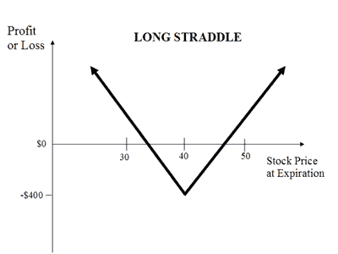
Improvement of Entry Signal
High Volatility
10%? 15%?
Notes:
In previous Long Straddle Strategy model, I assumed that when the volatility of underlying has been in the high value, Long Straddle would make money. After some analyzing with experienced traders, I noticed that I need more data to calculate this proper value that should be flexible and suitable with different marketing or underlying product.

Slide 70
Improvement of Entry Signal
Version 1：
Set High Volatility Condition > 10%
Notes:
I will step to step improve that value

Slide 71
Improvement of Entry Signal
Assumption one, volatility “trend” will last 4 days at least. The “trend” includes five cases: always up trend, always down trend, first up and then down trend, first down and then up trend, remain “flat” trend.

Slide 72
Improvement of Entry Signal
Another 6 month tick data
Calculate the 4 days return of HSI
Volatility:
Mean=0.009
Max=0.018
Min=0.002

Slide 73
Improvement of Entry Signal
Version 2:
Updated High Volatility Condition
= (mean + max) / 1.5 * 0.5 * SQRT(days)
= (0.009+0.018) / 1.5 * 0.5 * (240^0.5)
= 0.1394

Slide 74
Improvement of Entry Signal
Assumption two, if assumption one make sense and historical implied volatility is smaller than today’s implied volatility, then the volatility will increased at least one day. “Trend” is confirmed.
In Version 3, I added one condition before Long Straddle: historical implied volatility must be smaller than today’s implied volatility

Slide 75
Improvement of Entry Signal
Assumption three, if assumption one make sense and implied volatility of yesterday is smaller than implied volatility of today, then the volatility will increased at least one day. “Trend” is confirmed. (Version 4)
In Version 4, I modified Version 3: implied volatility of yesterday must be smaller than implied volatility of today.

Slide 76
Improvement of Entry Signal
Assumption four, even implied volatility of yesterday is bigger than implied volatility of today, as long as the implied volatilities on two consecutive days are bigger than “high volatility condition (0.1394)”, then the volatility will increased at least one day. “Trend” is confirmed.
In Version 5, I modified Version 4: the implied volatilities on two consecutive days must be bigger than “high volatility condition (0.1394)”.

Slide 77
Back Testing Result
Notes:
Version 1 give the biggest points return
Version 4 give the best performance, because the ratio of win to loss is biggest which means that version maybe make more money in

Slide 78
Back Testing Result
Notes:
For Version 1, the average point earned per trade give us best result, but, in my opinion, it’s lucky. Since entry signal almost occurs everyday, how much you earn depend on the average market performance of this month, no relevant with our algorithm. And we also know, in this month, the performance is quite well. Besides, the winning trade number and loss trade number is almost equal, so this version make no sense.
Chart 5.2.2 shows P&L in this month when employs version 1. You can see the trader occurs everyday.

Slide 79
Back Testing Result
Notes:
Let us observe the results from another view. Chart 5.2.3 below recorded the daily trade qty in a month: how many deals are losing money and how many are enjoying a profit. It’s quite clear that Day 1 ,Day 13, Day 19 witnessed the worst loss, thus, if we could decrease the trades volume on that two days, we will have a much better performance in profit in the month.

Slide 80
Back Testing Result
Notes:
For Version 2 and Version 3, we cut mostly trades in Day 1 and Day 13, but many wining trades also canceled due to the “wrong” signal (See Chart 5.2.4). And the winning trade number and loss trade number is almost equal as well, so Version 2 and Version 3 are failed.

Slide 81
Back Testing Result
Notes:
For Version 4, we successfully decrease the number of loss trade and cut down the total loss from -1616 to -774. As Chart 5.2.5, on day 19, Version 4 notably avoids many entry signals, which might lead to greater loss. Consequently, the total performance is pretty well and makes sense.

Slide 82
Back Testing Result
Notes:
In conclusion, Version 4 and Version 5 are acceptable and reasonable. I don’t know whether the Version 4 is over-fitting or not and whether the Version 5 will gain more profits in other occasion, which need more back testing.

Slide 83
Algo Trading
Background
Trading Strategies
Improvement of Long Straddle
Conclusion

Slide 84
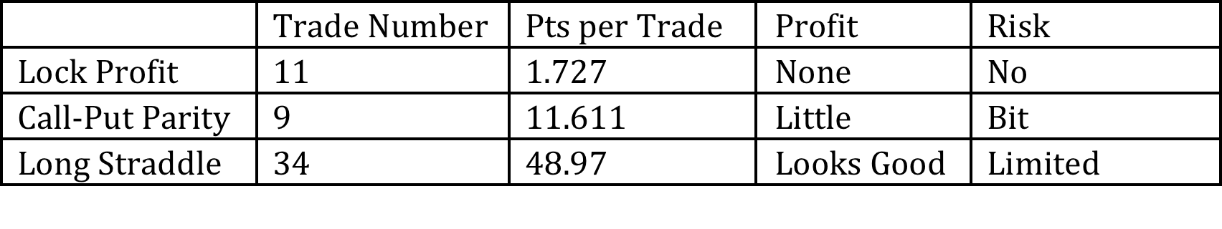
Conclusion
Notes:
So far, we construct three strategies that represented different risk management philosophies based on the Black-Scholes formula and some risk indicators.
For strategy 1 and 2, successes of algorithm rely on hardware capability and the process of algorithm is quite straightforward and almost risk-free. Obviously, Less risk means less profit.
For strategy 3, we step-by-step improve the entry signal that results in the impressive profit with limited risk. And also, methods and assumptions need more back testing to evaluate the effectiveness of parameters.

Slide 85
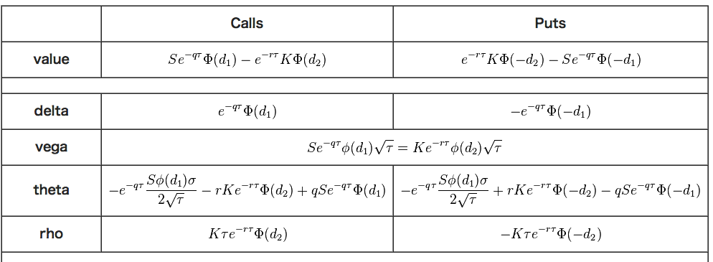
Conclusion
Notes:
Furthermore, the Greeks are vital indicators in risk management. Each Greek measures the sensitivity of the value of a portfolio to a small change in a given underlying parameter, so that Greeks can be incorporated into strategy design at a precise level using mathematical modeling and sophisticated software. But at a more basic level, the Greeks can be used as guideposts for where the risks and rewards can generally be found.
On the other hand, the Greeks in the Black-Scholes model are relatively easy to calculate and are very useful for derivatives traders, especially those who seek to hedge their portfolios from unpredictable changes in market conditions.
Through the Black-Scholes model is that it makes several assumptions that are not necessarily true in reality, we can deduce the indicators to price the value of option easily.

Slide 86
Programming Logic
Tick Data Reader
Read tick data to Mongo DB from CSV files
Strategy Processor
Apply Strategy to place order
Greeks Util Package
Calculate “Greeks” indicator (Gamma, Theta, Implied Volatility)
Bean Package
Entity of DB (Future, Option, Transaction)
CRUD job with Mongo DB
Strategy Performance Statistics Package

Slide 87
Programming Logic
Read Tick
Take Position
Greeks
Entry Signal
Place Order
Save Indicators
Adjust Position
Greeks
Adjust Condition
Place Adjust Order
Close Position
Exit Signal
Stop Loss
Stop Win
Log & Statistics
Sava Log
Create Performance Report
Read csv file
aggregate value

Slide 88
Thank You!
Notes:
Thank you my Supervisors prof. Hilton, he not only gives me well back testing environment but more important give me a lots advices

